Slide 1
Jermyn Borough Council Meeting
1/19/2023

Slide 2
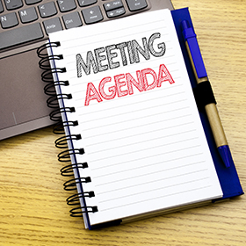
Meeting Agenda
January 19, 2023
CALL TO ORDER
PLEDGE OF ALLEGIANCE
ROLL CALL
PREVIOUS MEETING MINUTES
TREASURER REPORT/BILLS PAYABLE
PRESENTATION LAKELAND GIRLS CROSS COUNTRY TEAM
CORRESPONDENCE
DISCLOSURE OF EXECUTIVE MEETING HELD DECEMBER 27 TO DISCUSS PERSONNEL MATTERS RELATED TO THE NEED OF A PART TIME BOROUGH MANAGER
PROFESSIONAL REPORTS
POLICE
FIRE
SOLICITOR
CODE ENFORCEMENT
ZONING
ENGINEER
TAX COLLECTOR
MAYOR
COMMITTEE REPORTS
LACKAWANNA CTY HAZARD MITIGATION PLAN
AUDIT
LED LIGHT CHANGES
ADMINISTRATIVE STAFF APPOINTMENT
NEW BUSINESS

Slide 3
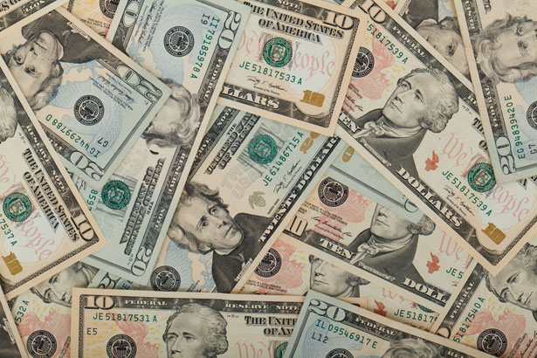
Treasurer’s report
1/19/2023
ASSETS
Checking/Savings
Capital Reserve - DPW 10,728.08
Capital Reserve - Police 4,871.82
Crime Watch Fund 222.69
General Fund - Community 105,440.55
General Fund - FNB 6,016.11
Holiday Lights Fund 1,424.09

Slide 4
Treasurer’s report
Investment - General Fund 1,013.82
Investment - Liquid Fuels 34,229.28
Investment - Paving Fund 1,024.35
Investment - Recycling 5,064.85
Investment - Refuse 2,632.16
Liquid Fuels - FNB 54.18
Petty Cash 227.00
Recreations Fund 25,115.59
Recycling - Community 11,693.84
Refuse Checking - FNB 52,810.88
Total Checking/Savings 262,569.29

Slide 5
Treasurer’s report
200000 · Accounts Payable 17,289.30
Long Term Debt 241,385.02

Slide 6
MS4 Minute
https://www.youtube.com/watch?v=-bvZCdMecEo&t=119s

Slide 7


